Slide 1
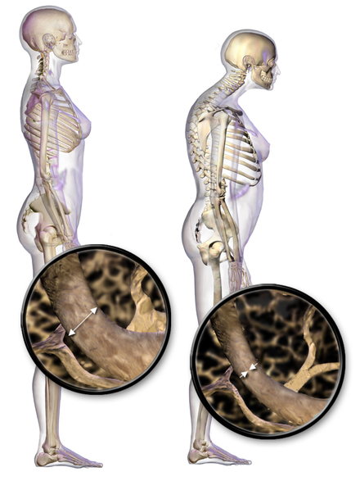
Analysis of osteoporosis data
-Developed By
Manisha Hyndavi Kandregula

Slide 2
Introduction
Osteoporosis is defined as low bone mineral density caused by altered bone microstructure, ultimately predisposing patients to low-impact, fragility fractures. Osteoporotic fractures lead to a significant decrease in quality of life, with increased morbidity, mortality, and disability.
Many studies report that vitamin D, calcium ,habits of the patient like alcohol consumption, smoking effects the bone density.
Few studies say that there is a genetic component to osteoporosis.
DEXA (dual x-ray absorptiometry) scans measure bone density (thickness and strength of bones) by passing a high and low energy x-ray beam (a form of ionizing radiation) through the body, usually in the hip and the spine.

Slide 3
Objectives
How many people are at high risk for osteoporosis?
How many patients in the data has history of fractures?
How Vitamin D and calcium levels effect DEXA score?
How alcohol and smoking impacts the bone density?
To extract the details of the patient with very less bone density i.e, patients who has osteoporosis.
To determine the correlation between the weight and DEXA score.
To know the combined effect of calcium and vitamin D levels on bone density.
Get the stats of patients with severe osteoporosis.
The mean difference of DEXA scores among different races.

Slide 4
Methodology
Data Cleaning
and manipulation
Data Merging
Analysis
Statistics
Visualisation
The final report

Slide 5
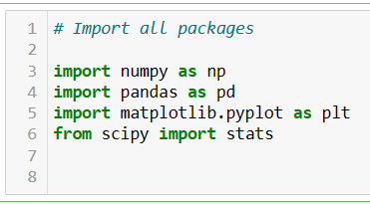
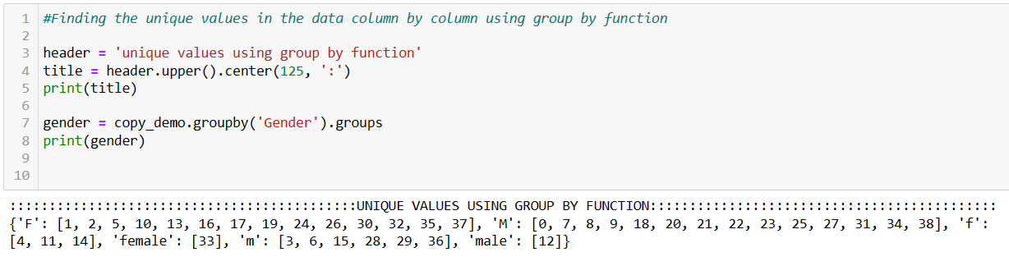
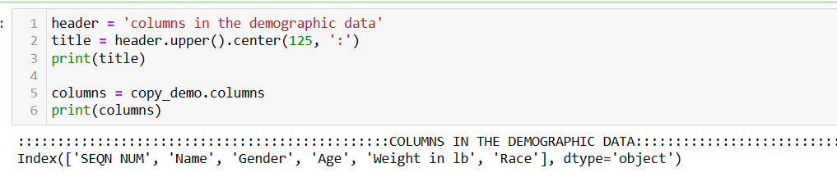
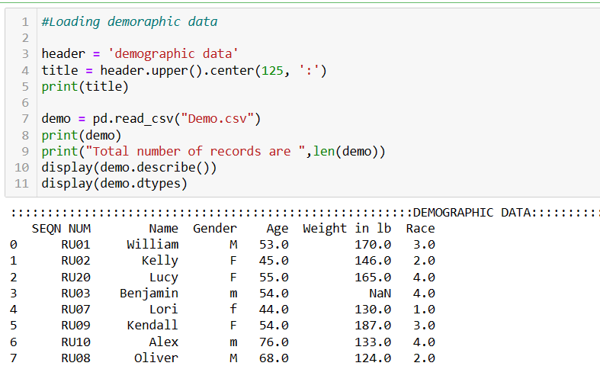
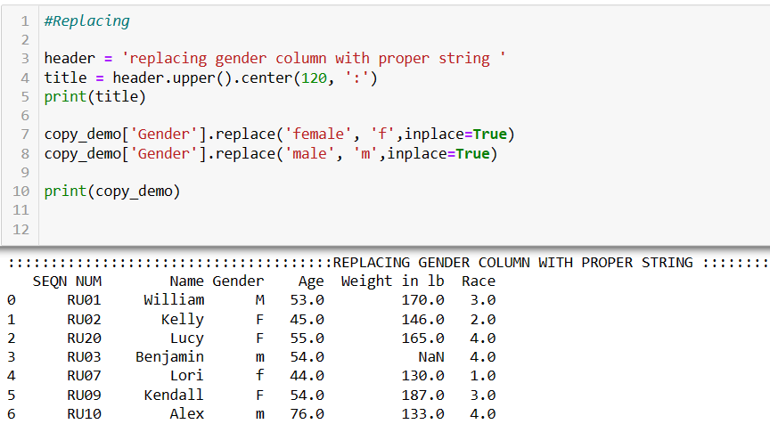
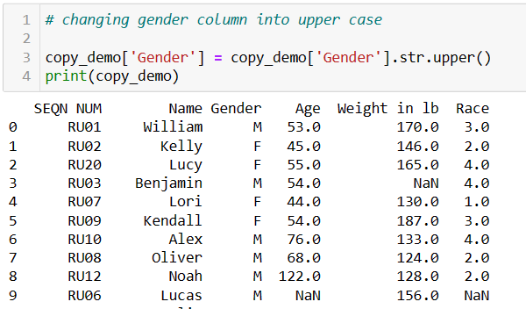
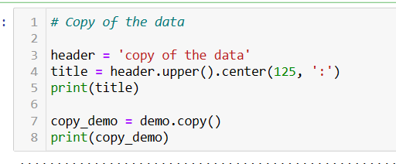
Import packages
Demographic Data loading and cleaning
Columns in the data
Finding unique values in Gender
Data Loading
Replace Gender
Case changing
Copy data

Slide 6
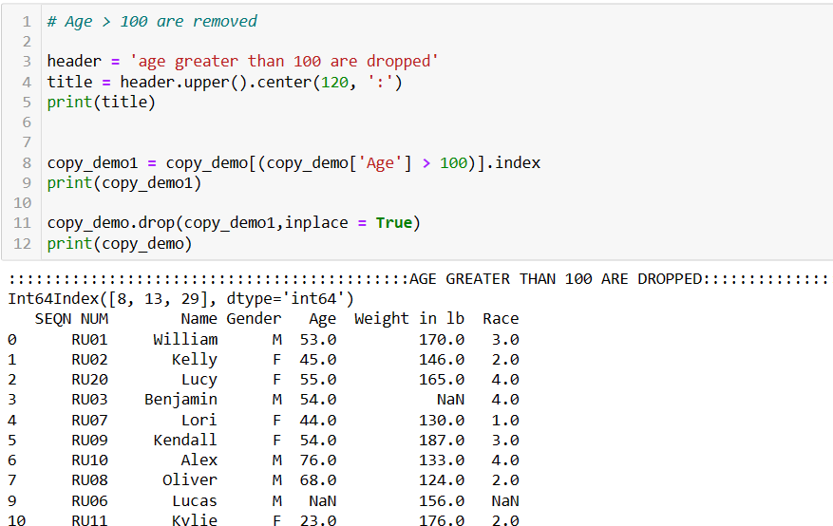
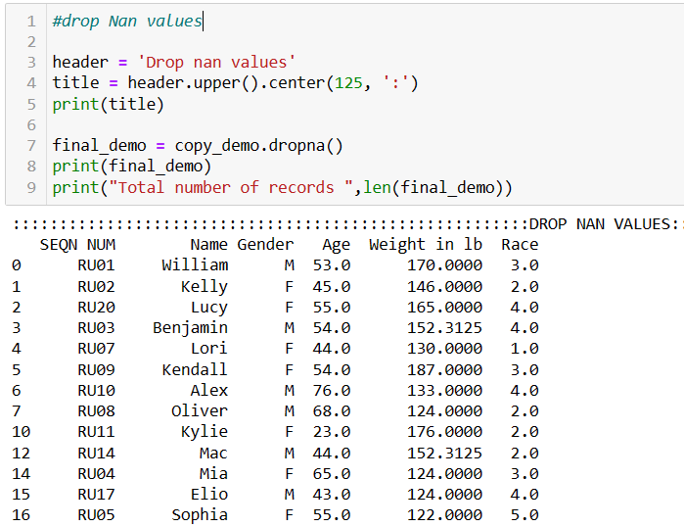
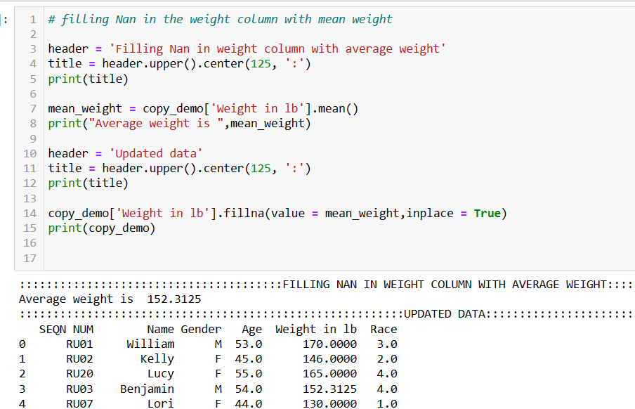
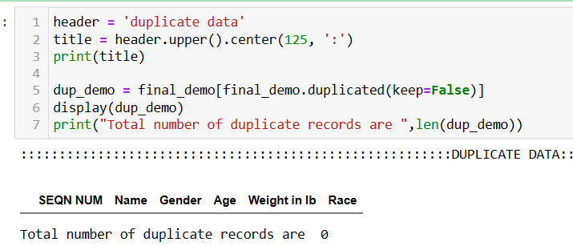
Age > 100 are dropped
Drop null data
Fill Nan with mean weight
Finding dup data

Slide 7
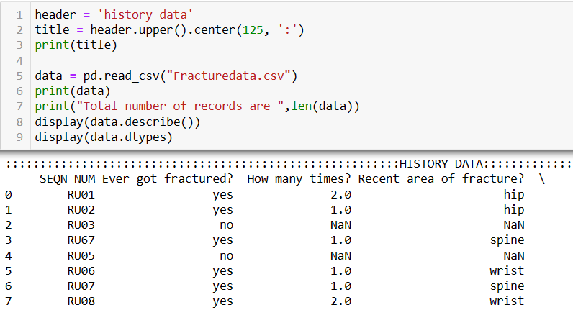
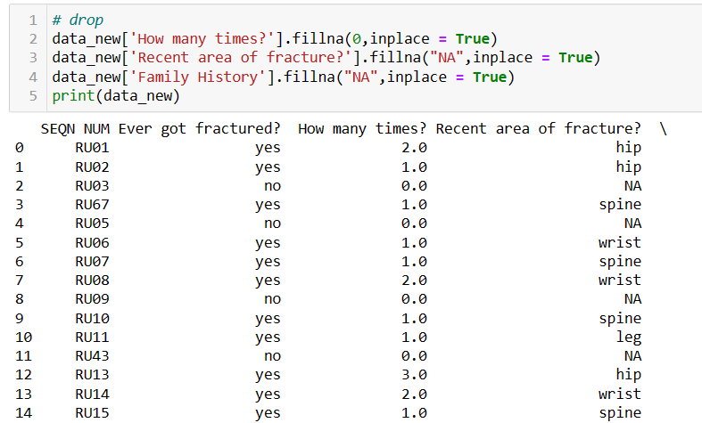
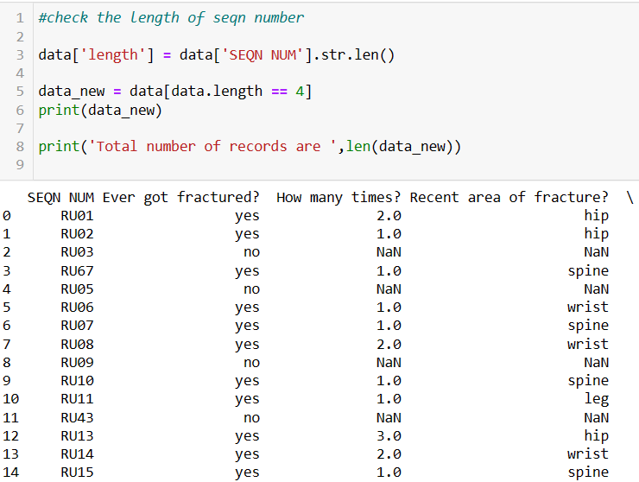
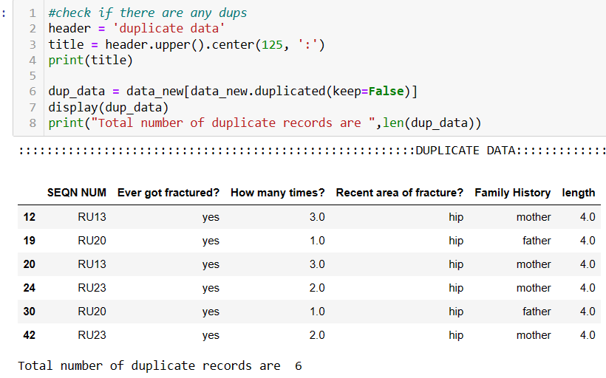
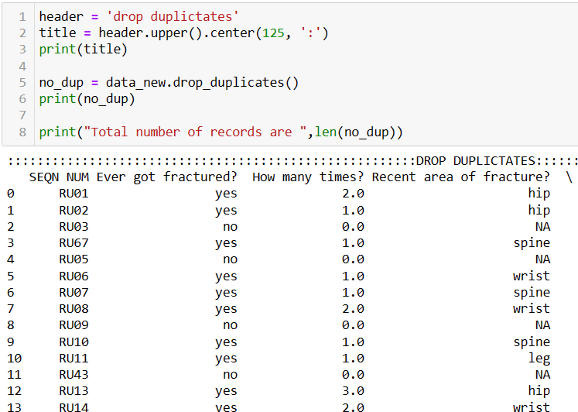
Loading history data
Fill missing values with 0 and NA
History Data loading and cleaning
Kept “SEQN NUM” whose length = 4
Check duplicates
Drop Duplicates

Slide 8
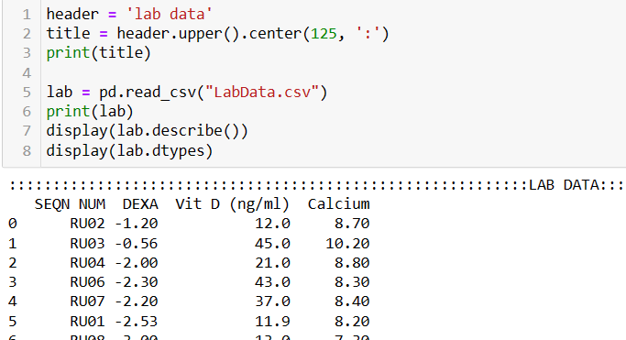
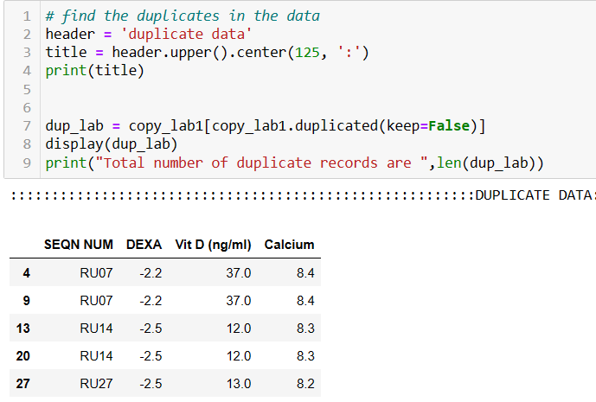
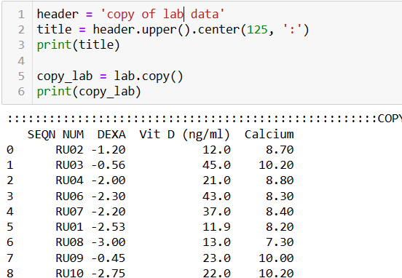
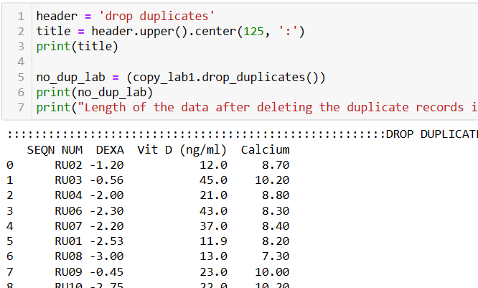
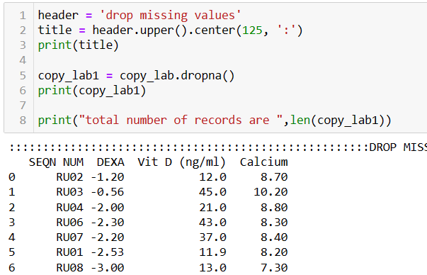
Loading Lab data
Find the duplicate data
Lab Data loading and cleaning
Copy of data
Drop Duplicates
Drop Null data

Slide 9
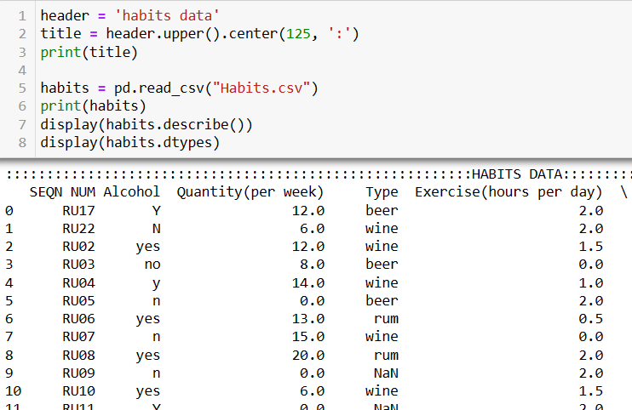
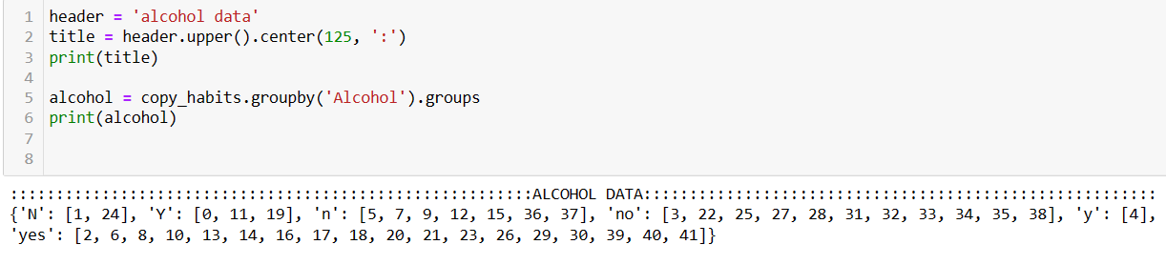
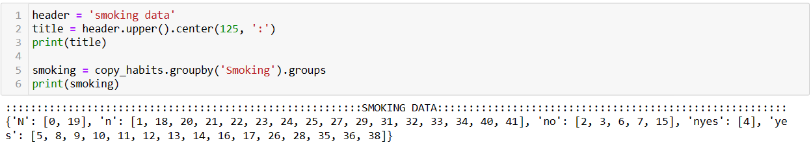
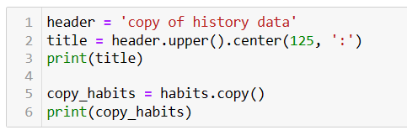
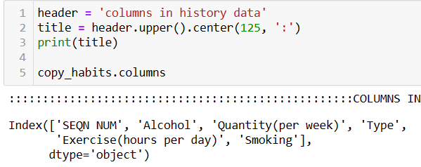
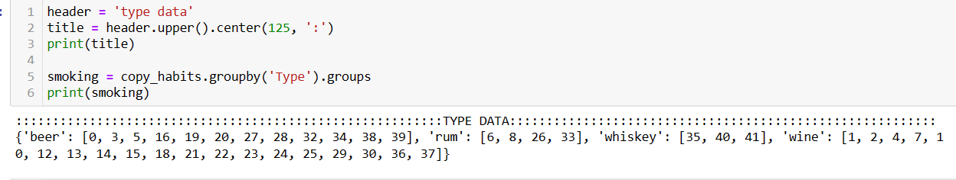
Loading habits data
Habits Data loading and cleaning
Group by Alcohol to see the junk data
Group by Smoking to see the junk data
Copy of the data
Columns in the data
Group by type to see the junk

Slide 10
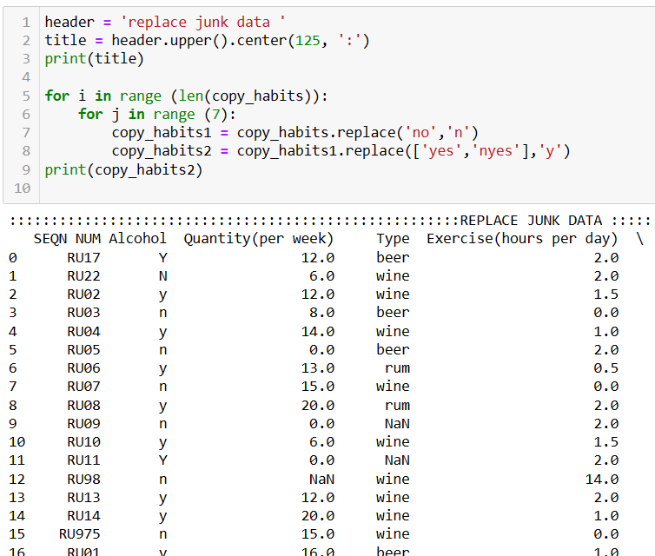
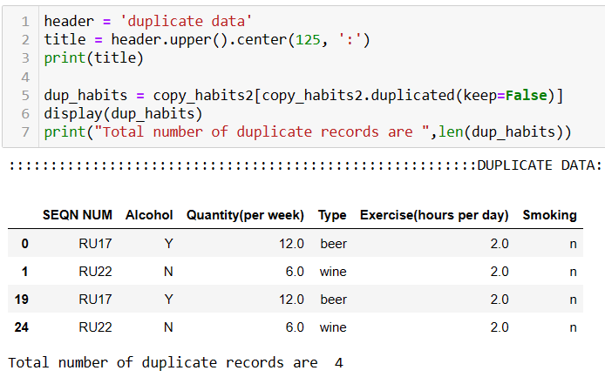
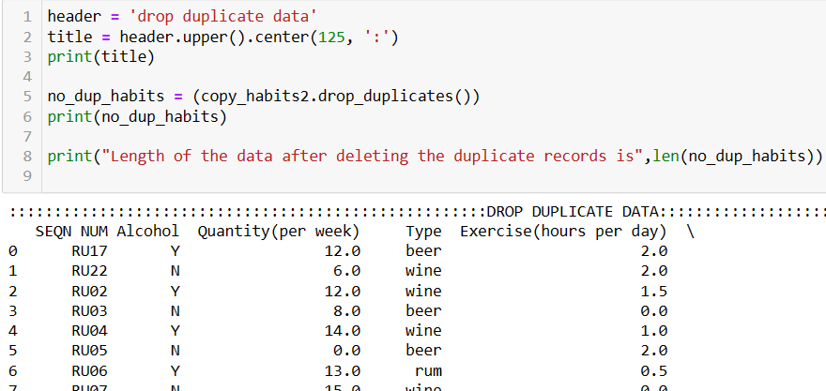
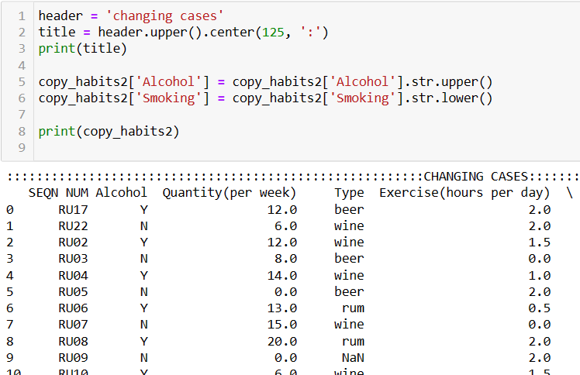
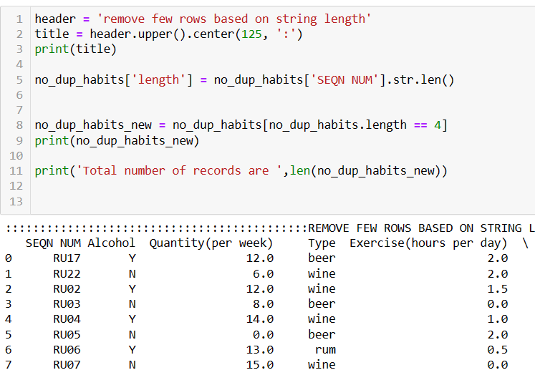
Replace Junk data
Replace Junk data
Find duplicate data
Drop duplicate data
Change cases
String length-based rows removal

Slide 11
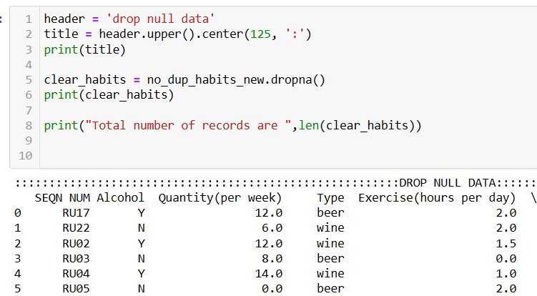
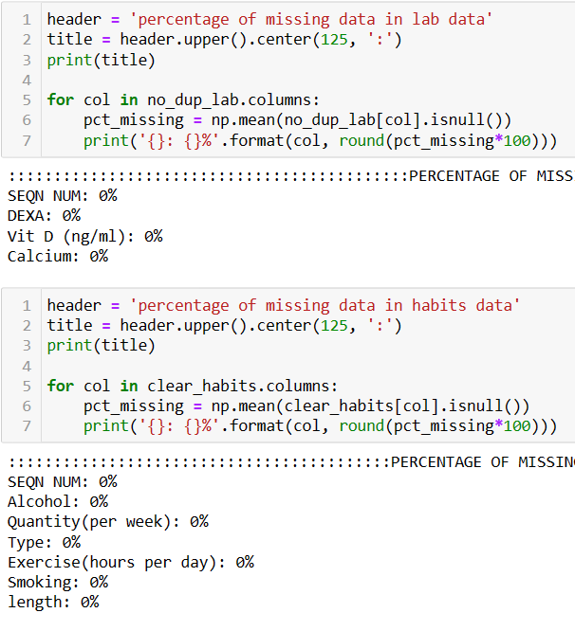
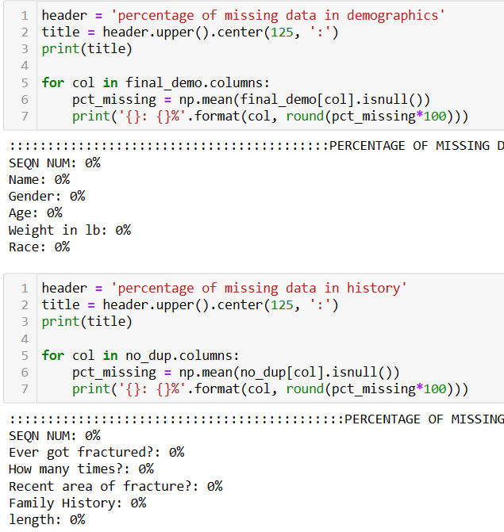
Drop Missing data
% of missing data after cleaning

Slide 12
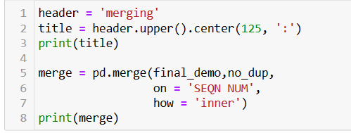
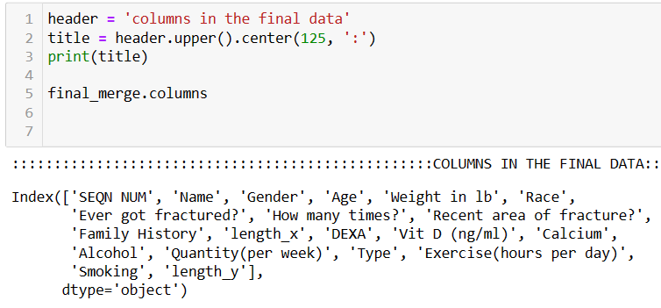
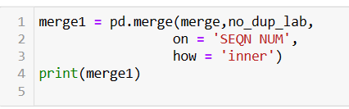
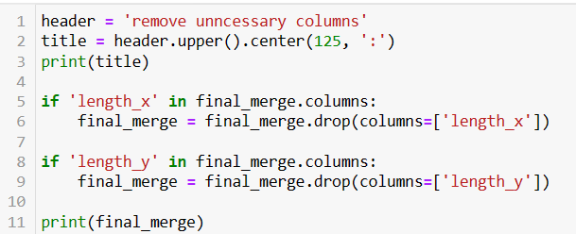
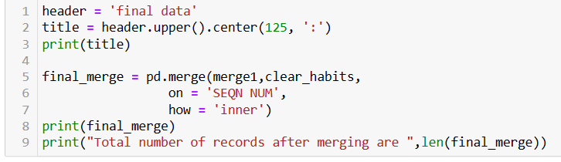
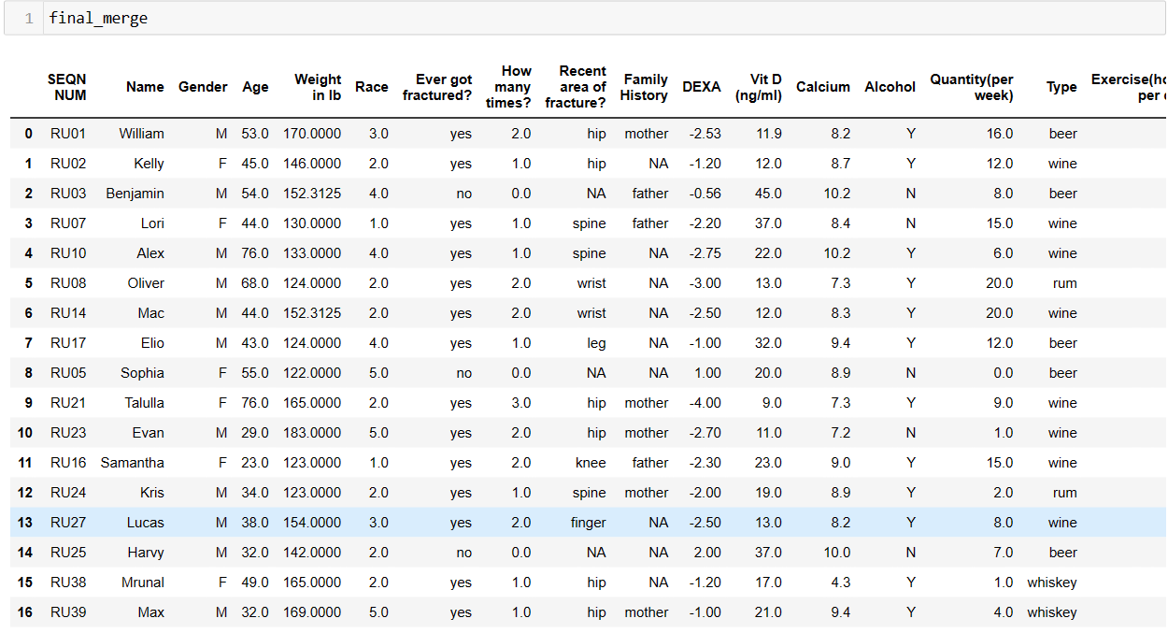
Merging
Merging
Columns in the merged data
Merging the data
Delete unwanted columns
Merged data

Slide 13
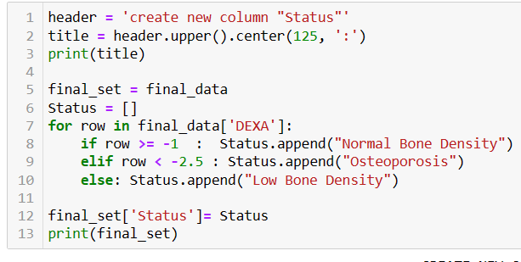
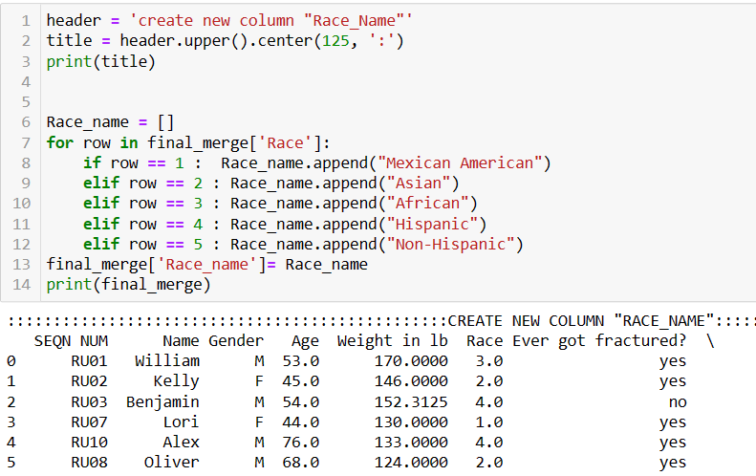
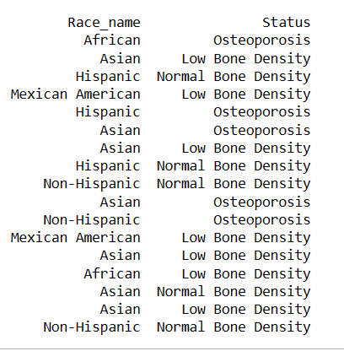
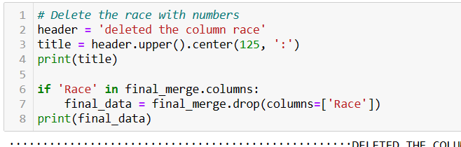
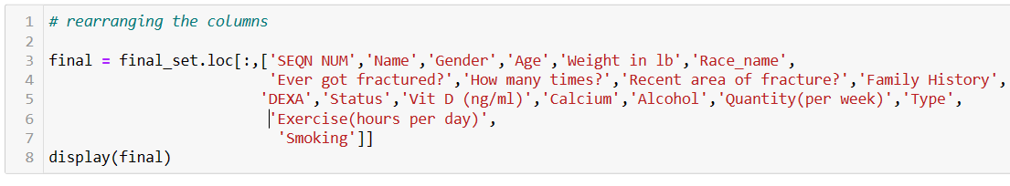
Create new column Status
Create new columns
Create new column Race name
New columns
Delete column “race”
Rearranging the columns

Slide 14
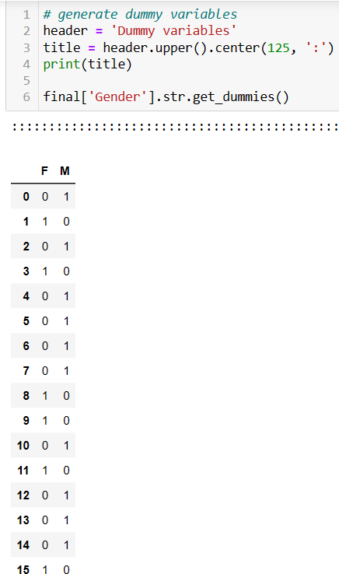
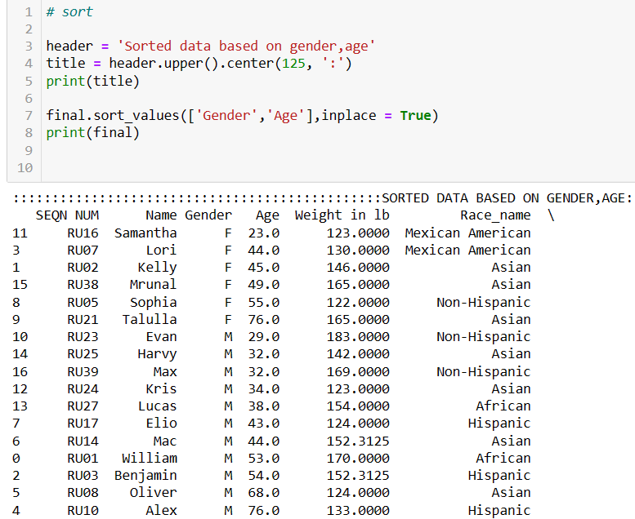
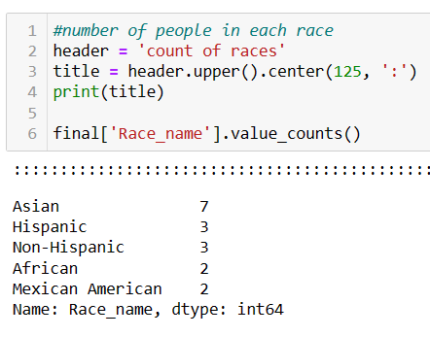
Dummy Variables
Sorted Data
Num of males and females in each race

Slide 15



Number of males and females in each category of status
Extract details of patient
Males with osteoporosis even they have no habit of alcohol and smoking

Slide 16

Correlation for all continuous variables
There is a negative correlation between alcohol intake and Vit D levels, which means if one variable increases, the other one decreases.
There is a negative correlation between DEXA score and weight, which means if one variable increases, the other one decreases.

Slide 17




Effect of alcohol and vit D levels on DEXA score
Effect of Cal & vit D on DEXA
Linear Regression
In both of them the P-Value is >0.05,which says that DEXA score depends on Vit-D, Alcohol intake and calcium levels

Slide 18



InferentialStatistics
The P value is < 0.05,hence we accept the alternate hypothesis, which means the mean of DEXA score is equal to the hypothesized value.
The P value is >0.05,hence we accept the null hypothesis, which means the mean of DEXA score is not same in males and females.
The P value is >0.05,hence we accept the null hypothesis, which means the mean of DEXA score is not equal in all races.

Slide 19




Histogram
Visualizations
Pie chart

Slide 20




Box Plot
Scatter Plot

Slide 21




3-D Bar graph

Slide 22
Observations in visualizations
According to histogram many patients have 1-2 fractures according to the data.
According to pie chart, most of the patients participated in the study are Africans (41.2%).
According to box plot, average DEXA score among patients is below 0 to -1 and average quantity of alcohol taken by patients is 7 to 8 drinks per week.
According to scatter plot, density of bone decreases with the increase of intake of alcohol .
3D Bargraph shows all the stats of patients with severe osteoporosis.

Slide 23


Counts and functions which helps to generate final report

Slide 24



The
Final
report

Slide 25







Slide 26





Slide 27
Conclusion:
There are 14 members with the history of fractures.
Eight members in our study has family history.
Average DEXA score for the patients participated in the study is -1.67.
Three members in the data has osteoporosis along with less vitamin-D and calcium levels.
Seven patients are at high risk of effecting with osteoporosis as they have low bone density.
There is a negative correlation between the age and DEXA score, which means when age increases the bone density decreases.

Slide 28


